Slide 1

A PROJECT PRESENTATION
ON
QuickBuy (Online Shopping Application)
SUBMITTED BY
Group No - 13
KURBANALI A MASU - 18082221021
B.Sc.(CA&IT) – VI
U16A5PRII – Industrial Project - II
PROJECT INTERNAL GUIDE
Mr. Jaimit R Patel
SUBMITTED TO
Department of Computer Science,
Ganpat Vidyanagar - 384012

Slide 2
PROJECT PROFILE
Project Name | QuickBuy
Objective | E-Commerce drives profitable growth by expanding customer reach, reducing cost-to-serve, and creating differentiated customer experiences
Front End Tool | Swift 5.3
Back End Tool | Firebase
Other Tools | XCode (12.1) , Algolia
Platform of application | Mobile (IOS)
Internal Project Guide | Mr. Jaimit R Patel
Time Duration | 120 Days
Submitted to | Department of computer science, GANPAT UNIVERSITY

Slide 3
EXISTING SYSTEM
In the existing system, customer have to go at store and then buy the products.
In the traditional type of system, customer have limited options of the products while in the E-Commerce application customer have huge amount of options.
If we have to buy various types of products in traditional type of system, we have to visit different stores.

Slide 4
NEED FOR NEW SYSTEM
Customers can spend less time to shop for what they want. They can easily browse through many items at a time and buy what they like.
In E-commerce application, customer can buy cheaper products compare to traditional store.
E-Commerce application allows you to provide more information about your products to customer.

Slide 5
HARDWARE REQUIREMENT
SERVER SIDE
System | Any Web-browser supporting system
Disk Space | 1GB Free space Recommended
CLIENT SIDE
System | Any IOS Mobile device
RAM | 2GB or more
Disk Space | 1GB or more

Slide 6
SOFTWARE REQUIREMENT
SERVER SIDE
Web Browser | Any web browser for Firebase SDK
CLIENT SIDE
IOS Version | IOS version 13 or later

Slide 7
USERS OF THE APPLICATION
CUSTOMER
ADMIN

Slide 8
CUSTOMER MODULE SPECIFICATIONS
REGISTRATION
LOGIN
SEARCH ITEM
MANAGE CART
MANAGE ORDERS
MANAGE PROFILE

Slide 9
ADMIN MODULE SPECIFICATIONS
LOGIN
ADD ITEMS
UPDATE ITEM
DISABLE ITEM
MANAGE CUSTOMER’S ORDERS

Slide 10
SYSTEM FLOW-CHART
START
Yes
Is Admin ?
Admin Login
No
Registered ?
No
Want to
Register ?
No
No
Valid Details ?
Yes
Yes
Login
Registration
Valid Details ?
Yes
No
Yes
A
U
X

Slide 11
A
U
X
Add Item
Search Item
Update Item
Manage Cart
Disable Item
Manage Orders
Manage Customer’s Orders
Manage Profile
C
Logout
END

Slide 12
E-R DIAGRAM
Full
Address
Image Name
First
name
Email
Object ID
Name
Full
Name
Onboard
Category
User
1
Object ID
Is
Admin
1
1
Purchased Item Ids
Have
Object Id
Order Total Amount
Owner ID
Have
Have
1
1
Basket
Have
Object ID
Order Total Amount
Description
M
M
1
Have
M
Is Delivered
Orders
Price
M
Items
Order ID
Owner ID
Image Links
Order Item Ids
Category ID
Name

Slide 13
DART FLOW DIAGRAM
Context - Level Diagram
End Users
QuickBuy
(Online Shopping app)
Admin
LOGIN
SEARCH ITEM
MANAGE CART
MANAGE ORDERS
MANAGE PROFILE
LOGIN
ADD ITEMS
UPDATE ITEM
DISABLE ITEM
MANAGE CUSTOMER’S ORDERS

Slide 14
1 - Level DFD
End User
E-mail & Password
Login
E-mail & Password
Firebase
Auth
Valid or Invalid
Valid or Invalid
Registration Details
Manage
Registers
Registration Details
Firebase
Auth
Registration Message
Registration Message
Search Item Name
Search Item
Search Item Name
Items
Collection
Item Details
Item Details
Cart Id
Manage Cart
Cart Id
Basket
Collection
Cart details
Cart details
Order ID
Manage Orders
Order ID
Orders
Collection
Order Details
Order Details
User Details
Manage Profile
User Details
User
Collection
User ID
User ID

Slide 15
1 - Level DFD : Admin
Admin
E-mail & Password
Login
E-mail & Password
Firebase Auth &
User Collection
Valid or Invalid
Valid or Invalid
Item details
Add Item
Item details
Items
Collection
response
response
Item details
Update Item
Item details
Items
Collection
response
response
Item details
Disable Item
Item details
Items
Collection
response
response
response
Manage Orders
response
Orders
Collection
Order details
Order details

Slide 16
DATA DICTIONARY
1. Users Collection
User collection stores the data of the users of application
Collection | Documents | Fields
Users | Document Name (String) | Email : String First Name : String Last Name : String Full Address : String Full Name : String Is Admin : Bool Object Id : String Category Id: String On Board : Bool Purchase Item Ids : Array (String)
Object Id → Object Id is a document name in each user’s document field.
Category Id→ Category Id refers the category of item from category collection.
On Board→ On board shows the have finished registration or not.

Slide 17
2. Category Collection
Category collection stores the items master type from where we can categories our items
Collection | Documents | Fields
Category | Document Name (String) | Name : String Image Name : String Object Id : String
Object Id → Object Id is a document name in each category’s document field

Slide 18
3. Items Collection
Items collection stores the data of the items
Collection | Documents | Fields
Items | Document Name (String) | Name : String Category Id : String Description : String Image Links : Array(String) Object Id : String Price : Double IsActive : Bool
Object Id → Object Id is a document name in each Item’s document field
Is Active → Is active shows the current item is active or not

Slide 19
4. Basket Collection
Basket collection stores the data of the basket per user
Collection | Documents | Fields
Basket | Document Name (String) | Item Ids : Array (String) Object Id : String Owner Id : String
Object Id → Object Id is a document name in each basket’s document field
Owner Id → Owner id represents the owner of the current basket

Slide 20
5. Orders Collection
Orders collection stores the data of the all user’s all orders.
Collection | Documents | Fields
Orders | Document Name (String) | Is Delivered : Bool Order Id : String Order Total Amount : Double Order Item Ids : Array (String) Owner Id : String
Is Delivered → Is delivered shows the status of order delivery
Order Id → Order Id is a document name in each Order’s document field

Slide 21
USER SIDE DESIGN

Slide 22
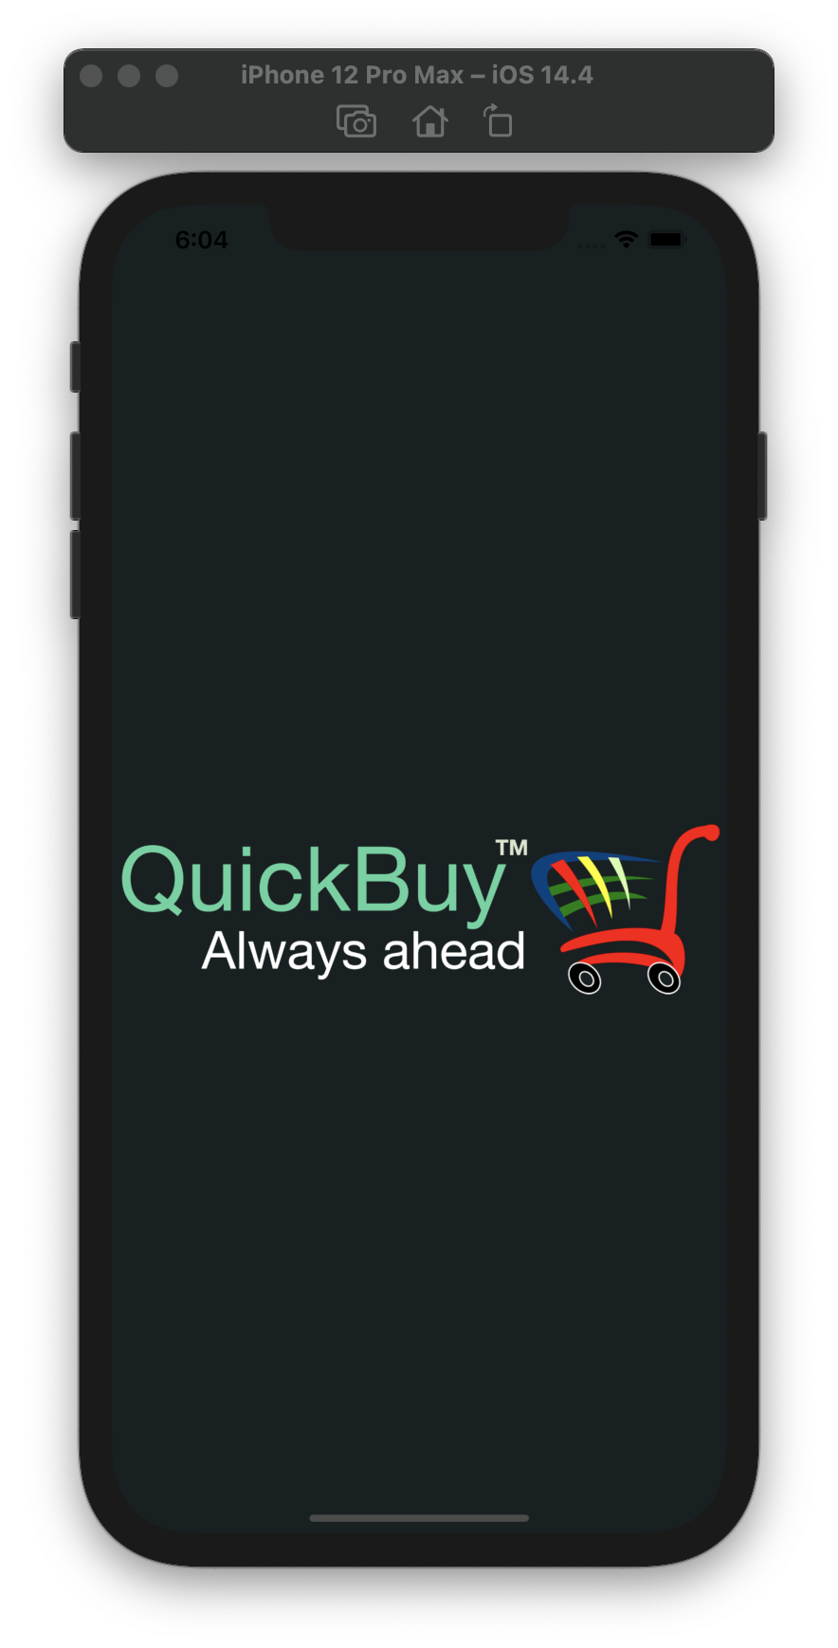
Splash Screen

Slide 23
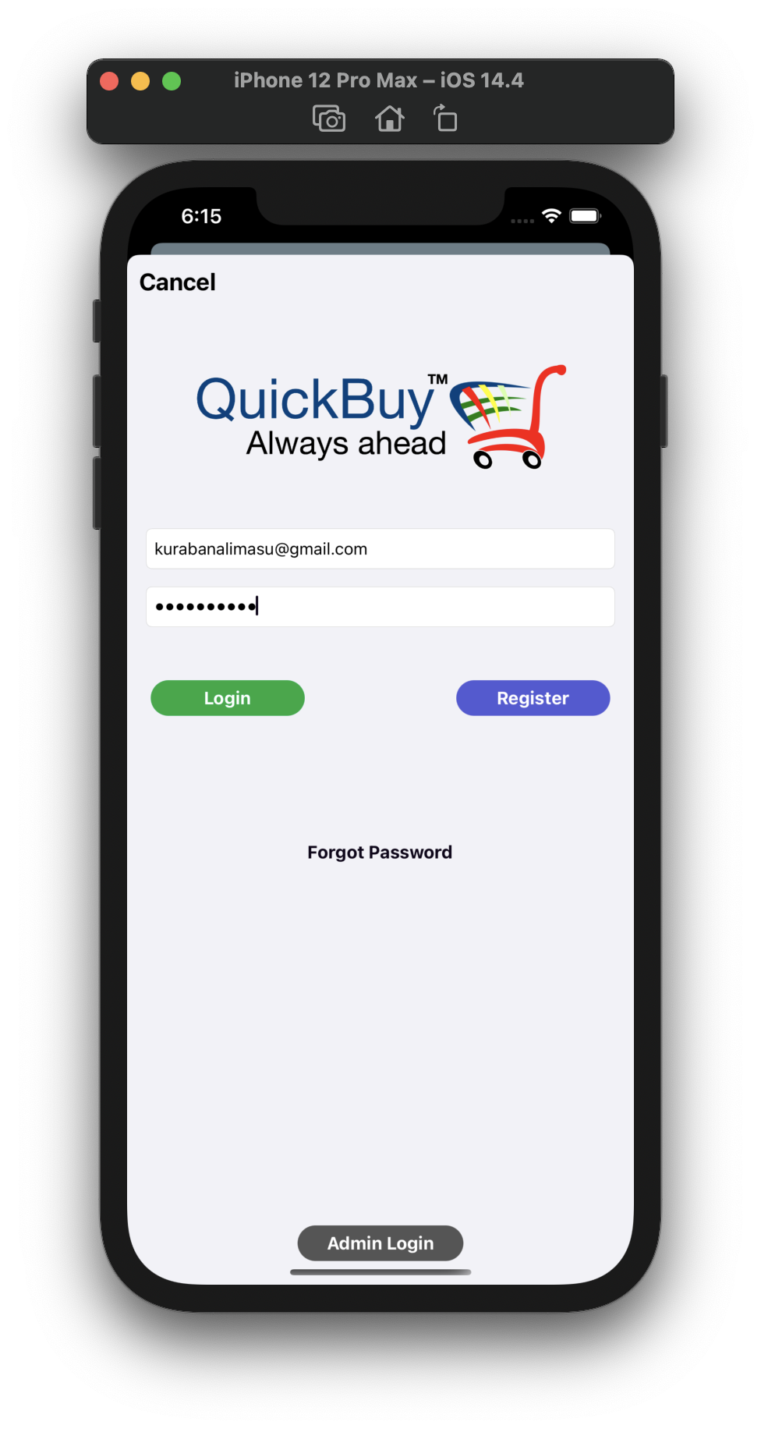
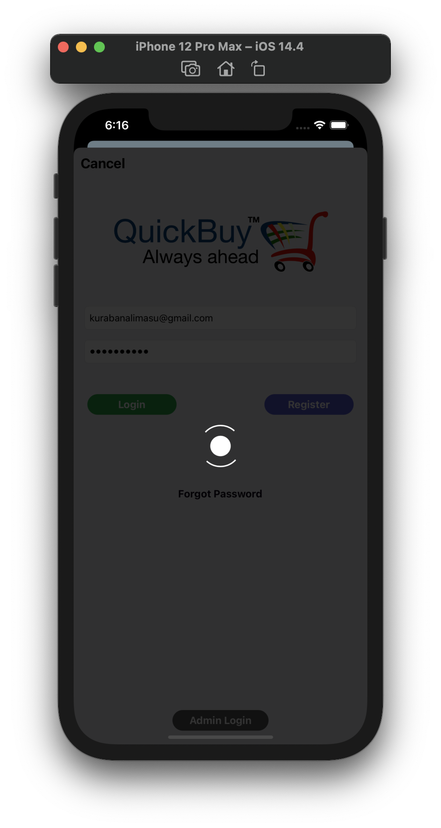
Login Screen
Login Screen
loading indicator

Slide 24
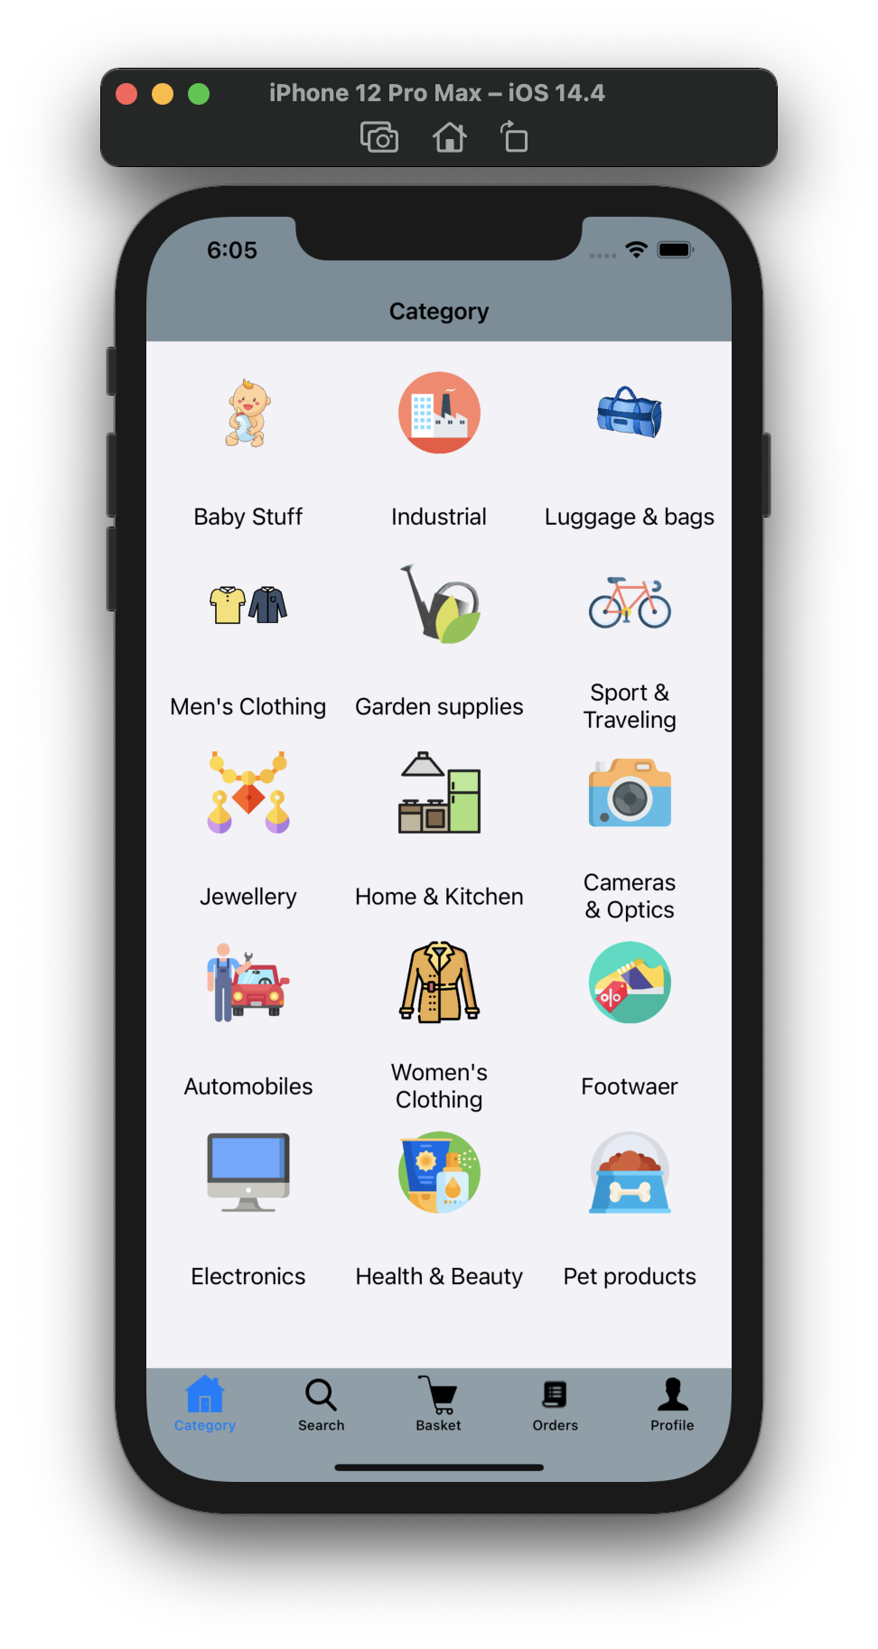
Category view screen

Slide 25
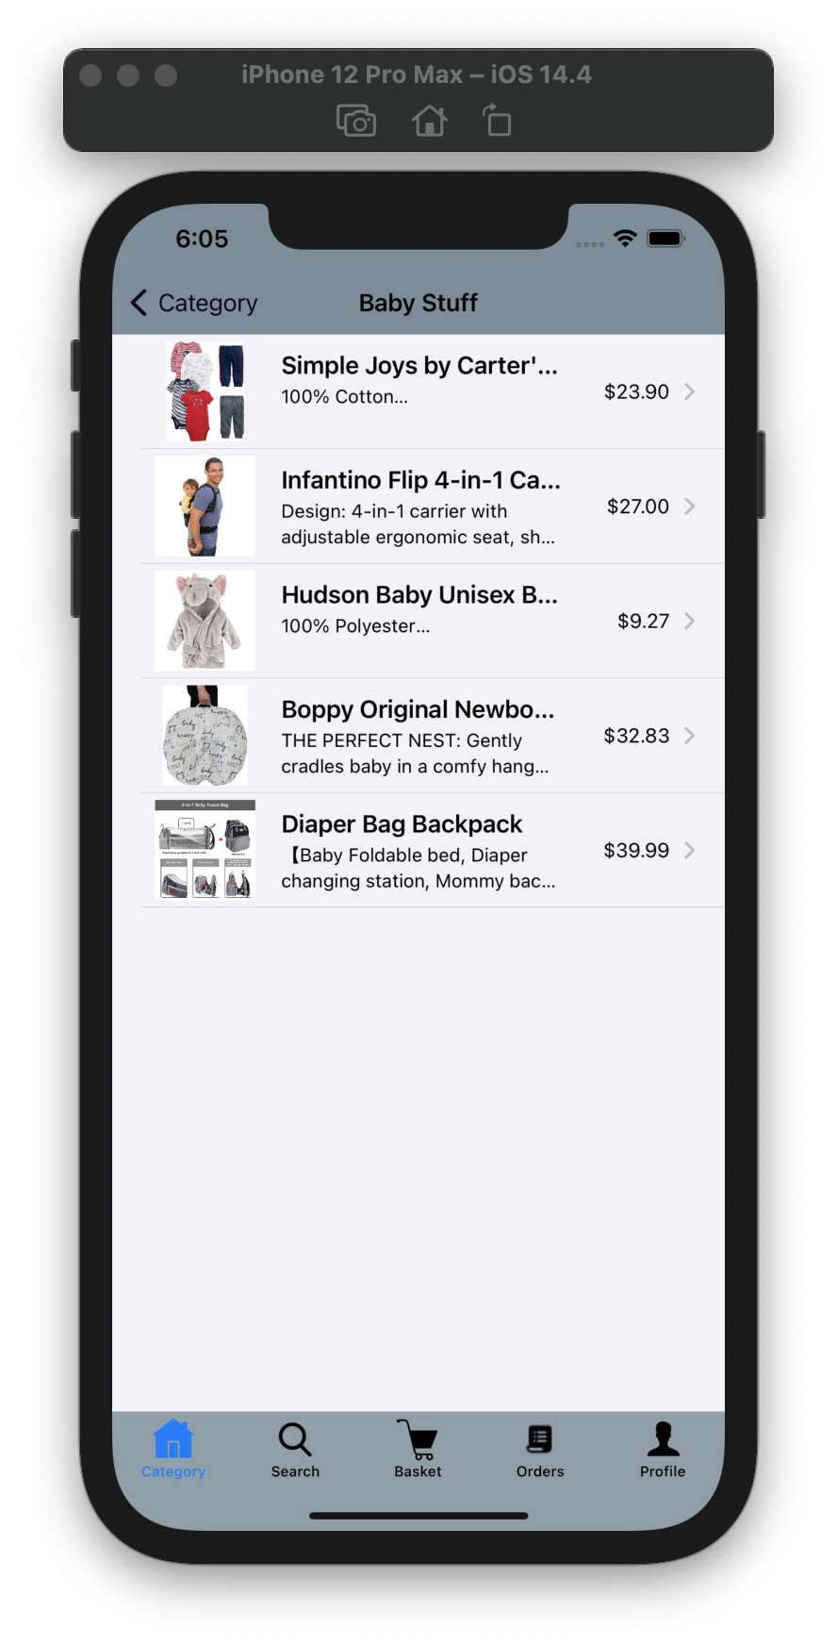
Items in category
view screen

Slide 26
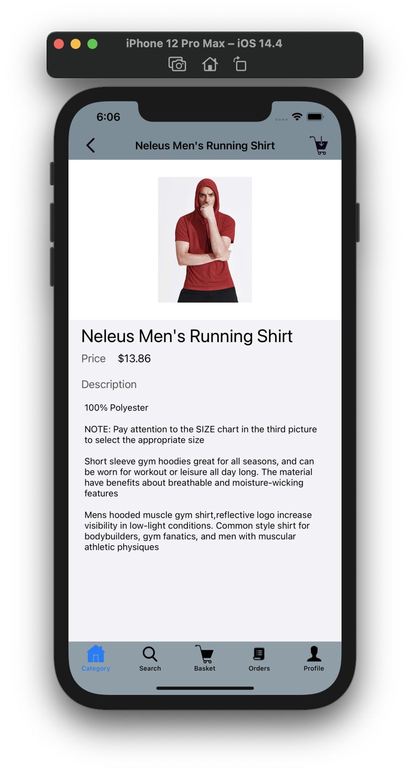
Items view screen

Slide 27
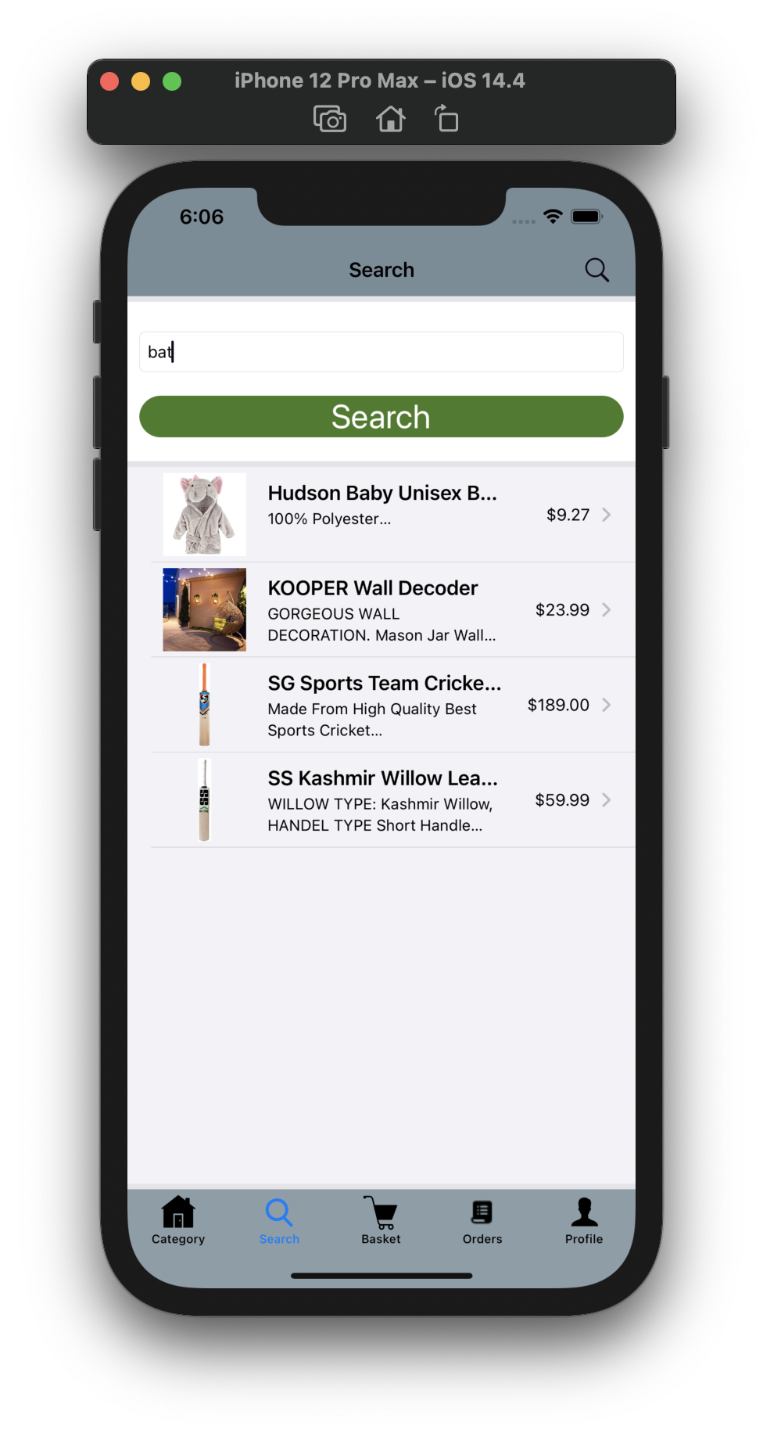
Search view screen

Slide 28
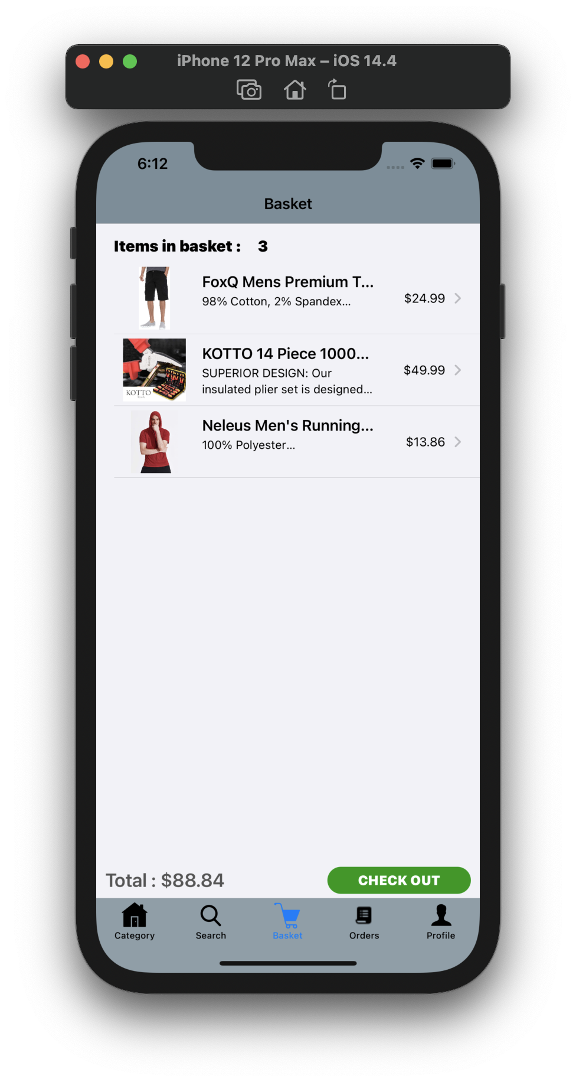
Cart view screen

Slide 29
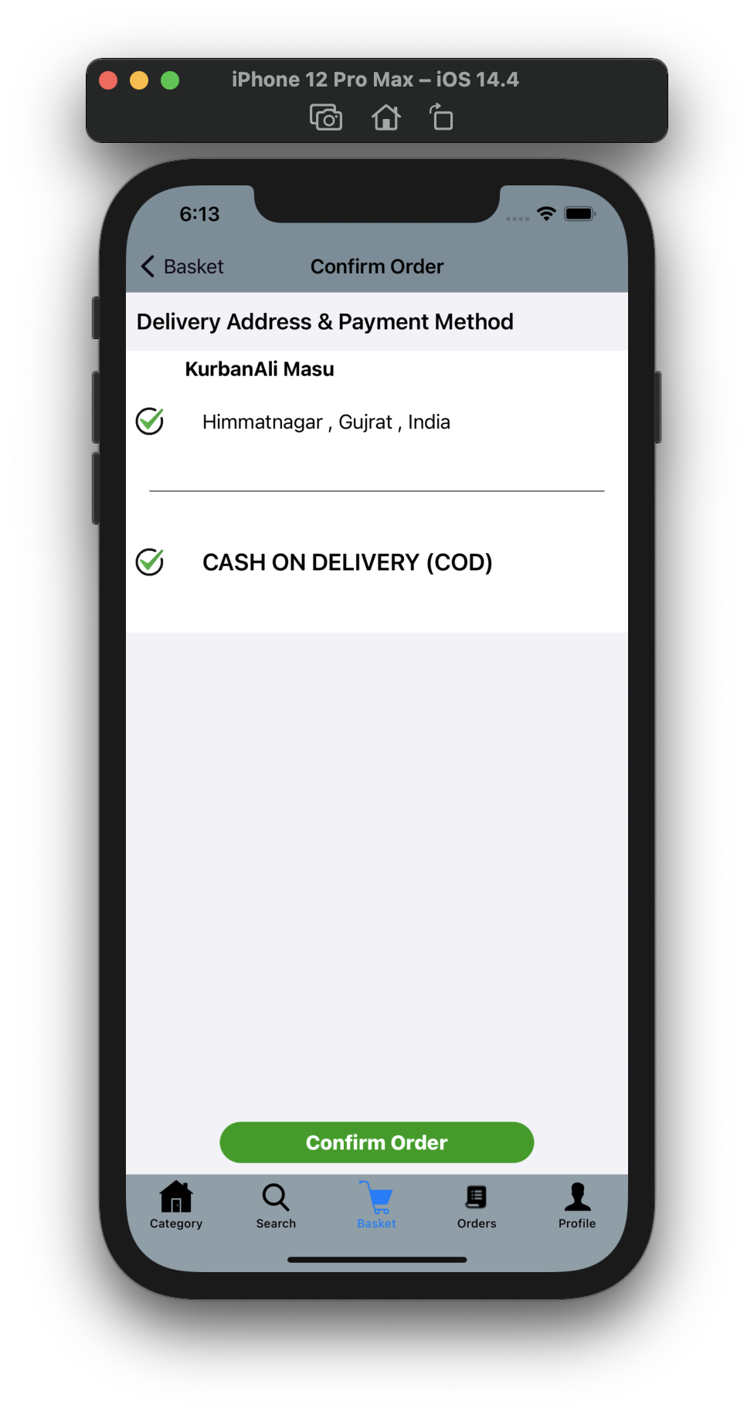
Confirm order
view screen

Slide 30
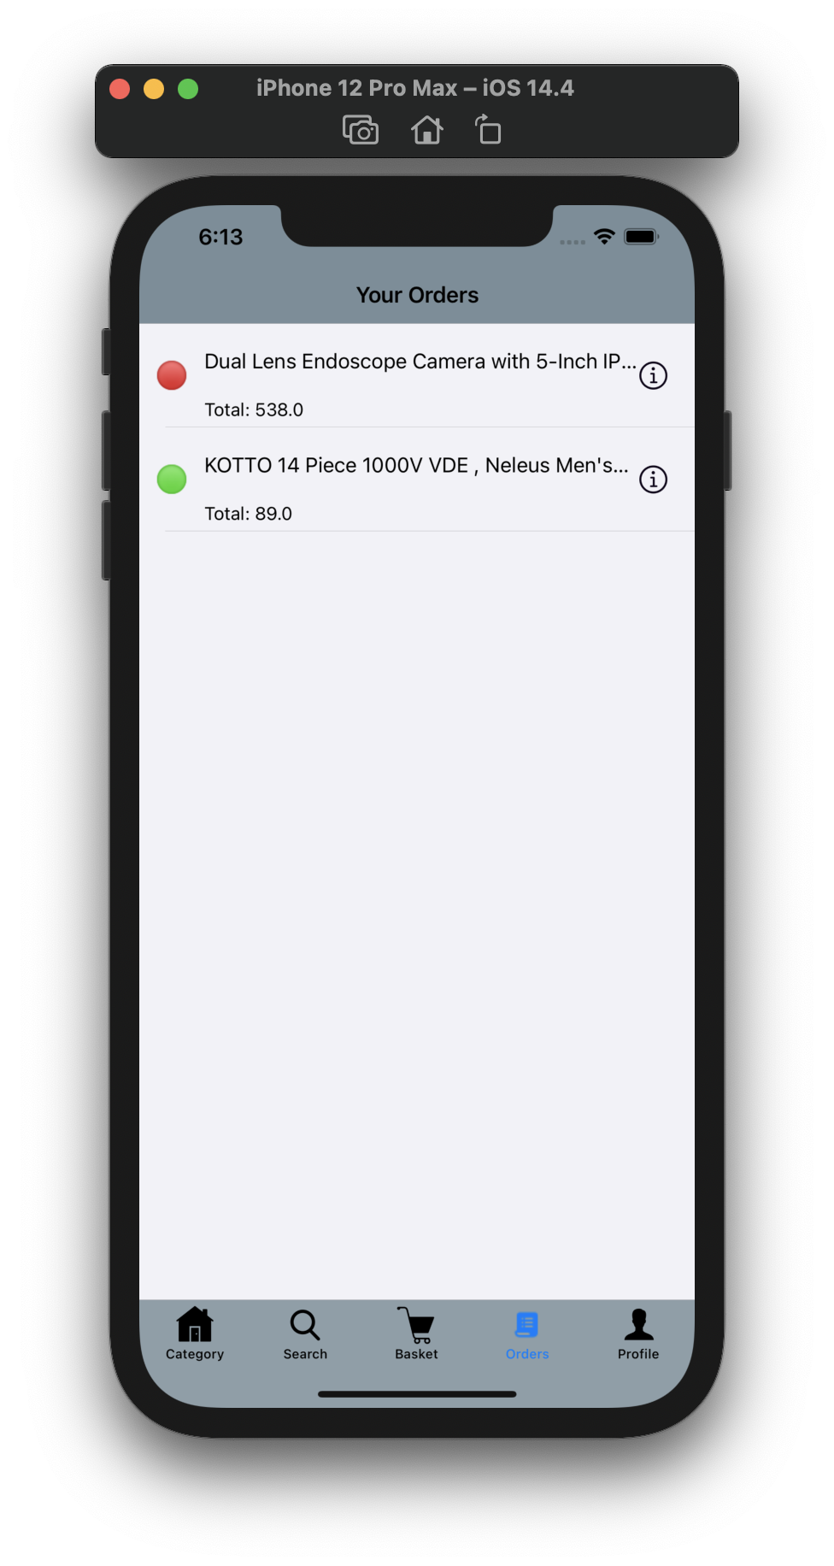
Orders view screen

Slide 31
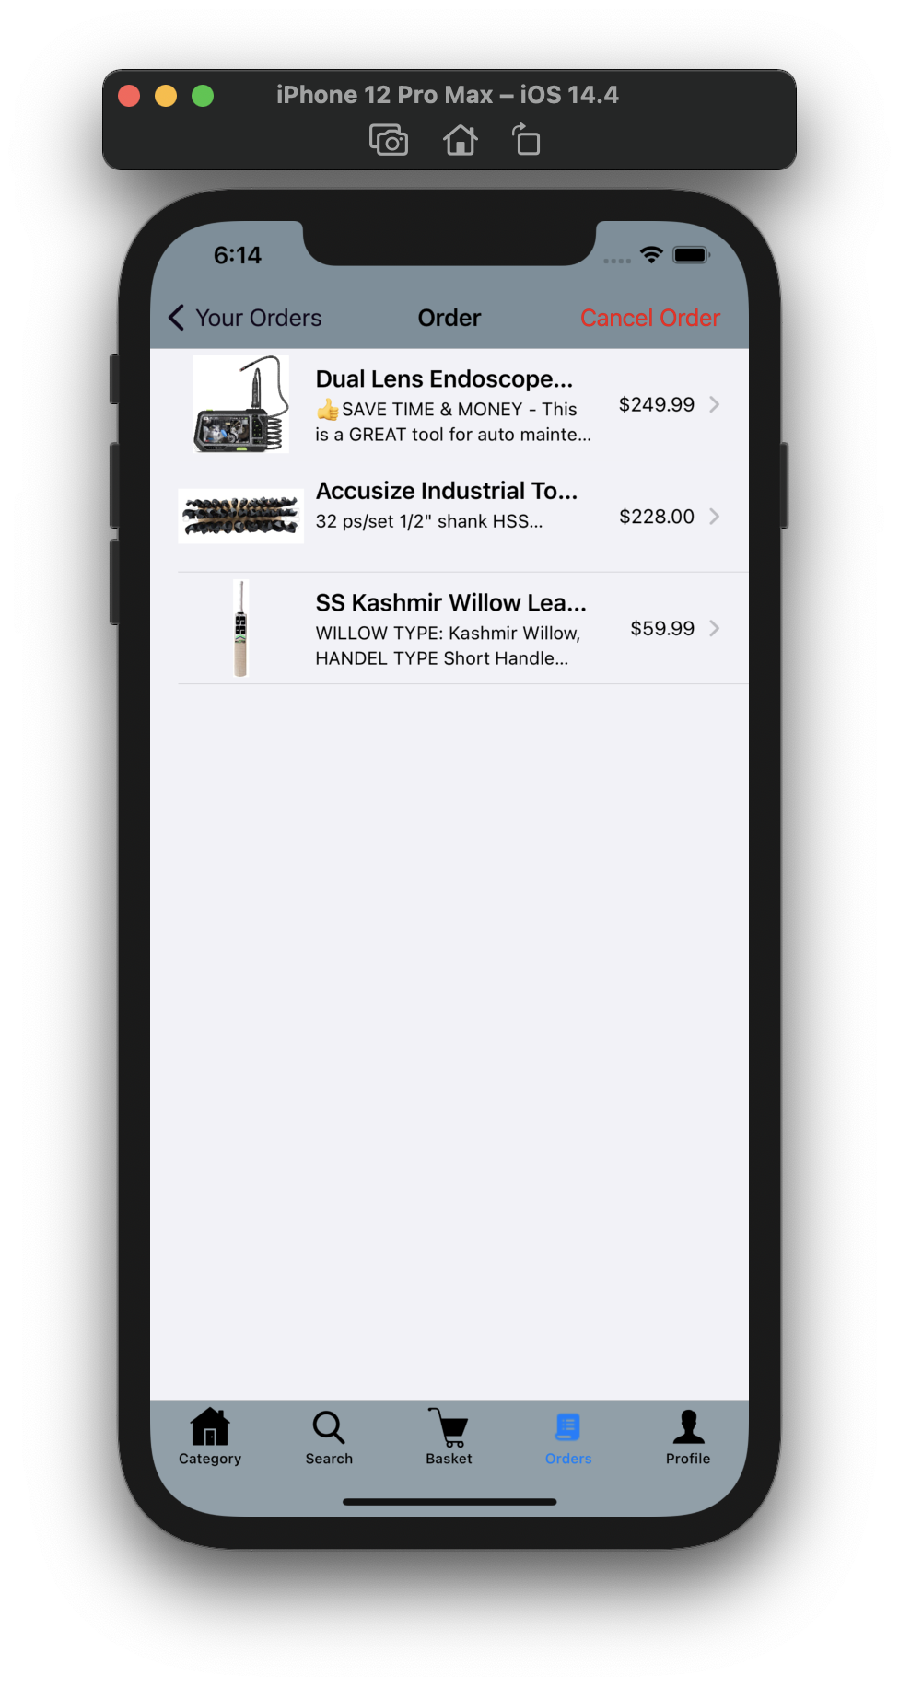
Order details
view screen

Slide 32
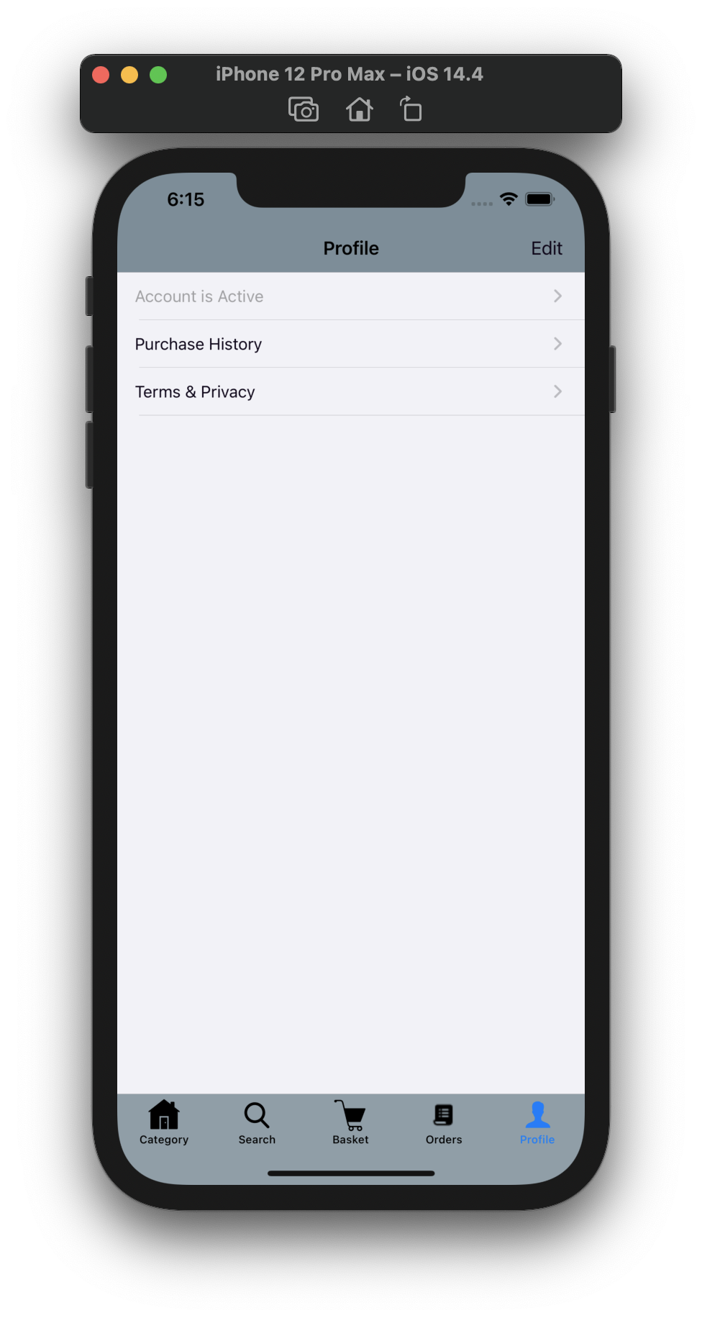
Profile view screen

Slide 33
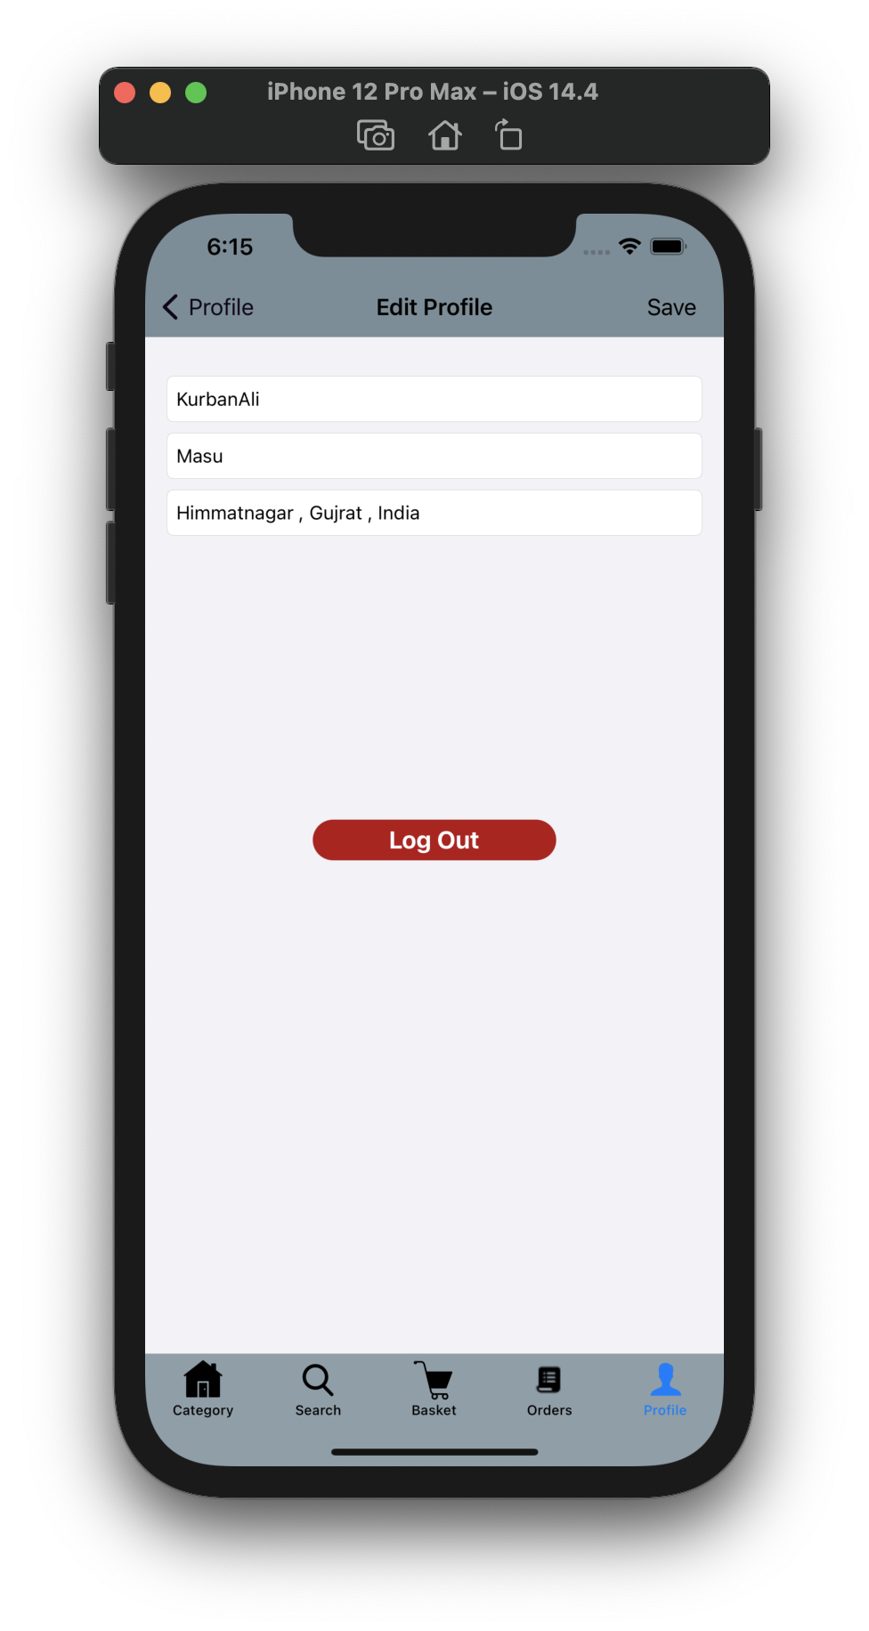
Edit profile
view screen

Slide 34
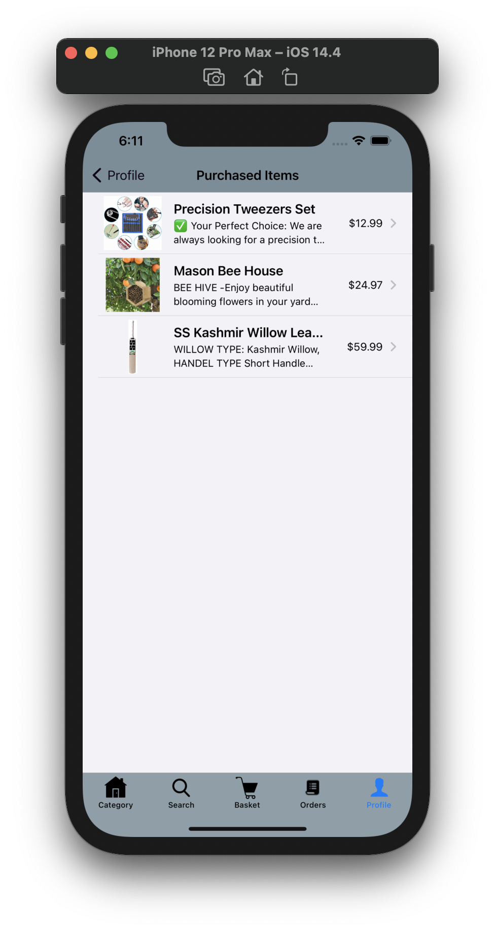
Purchase history
view screen

Slide 35
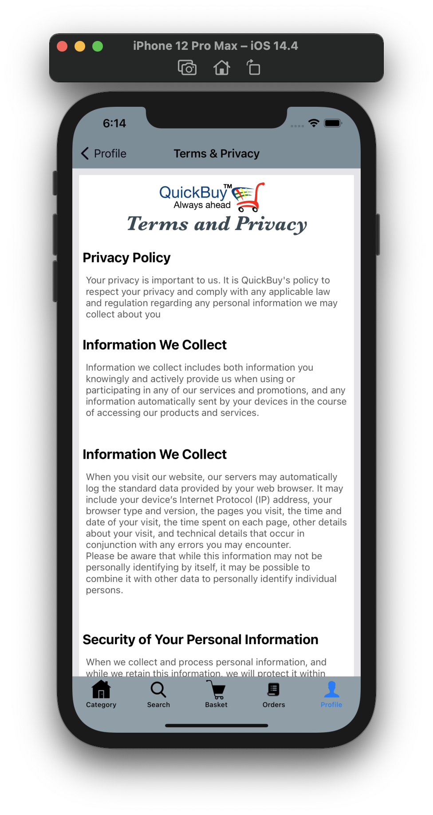
Terms and privacy
view screen

Slide 36
ADMIN SIDE DESIGN

Slide 37
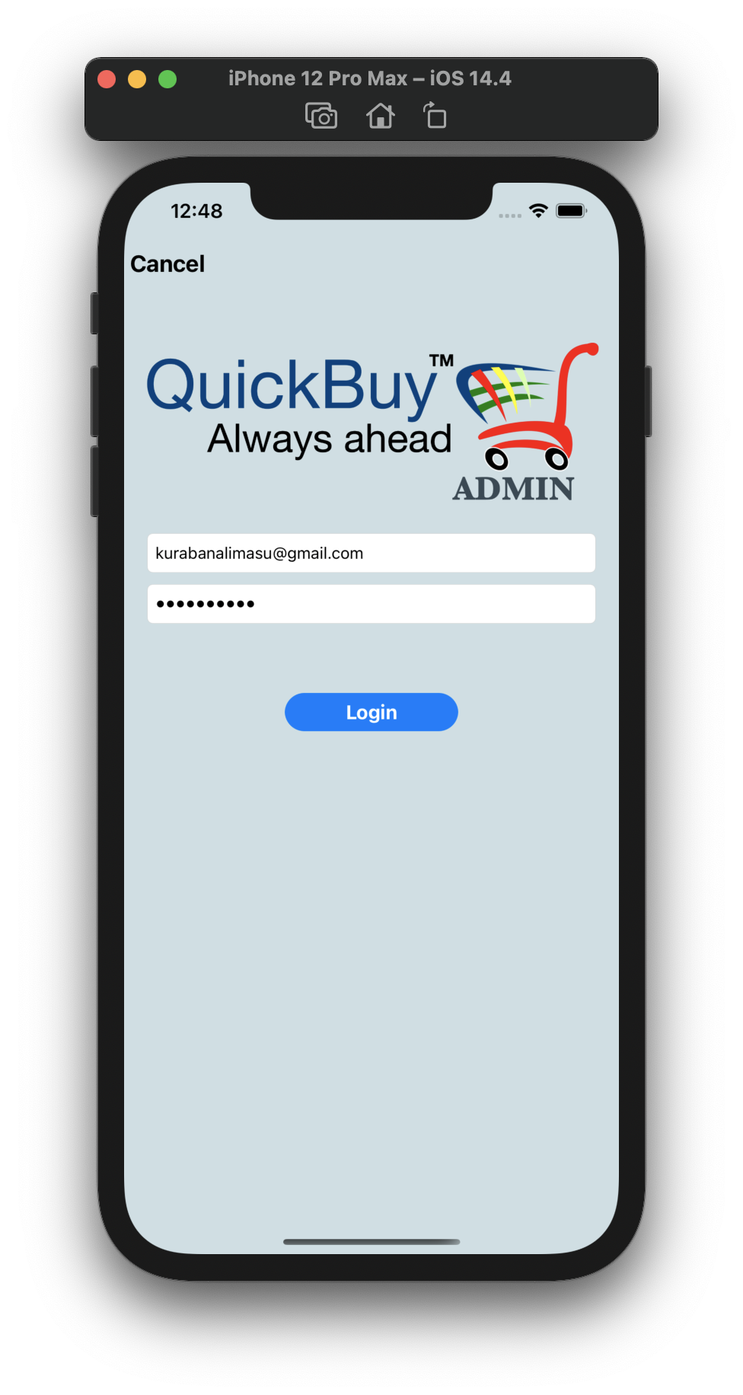
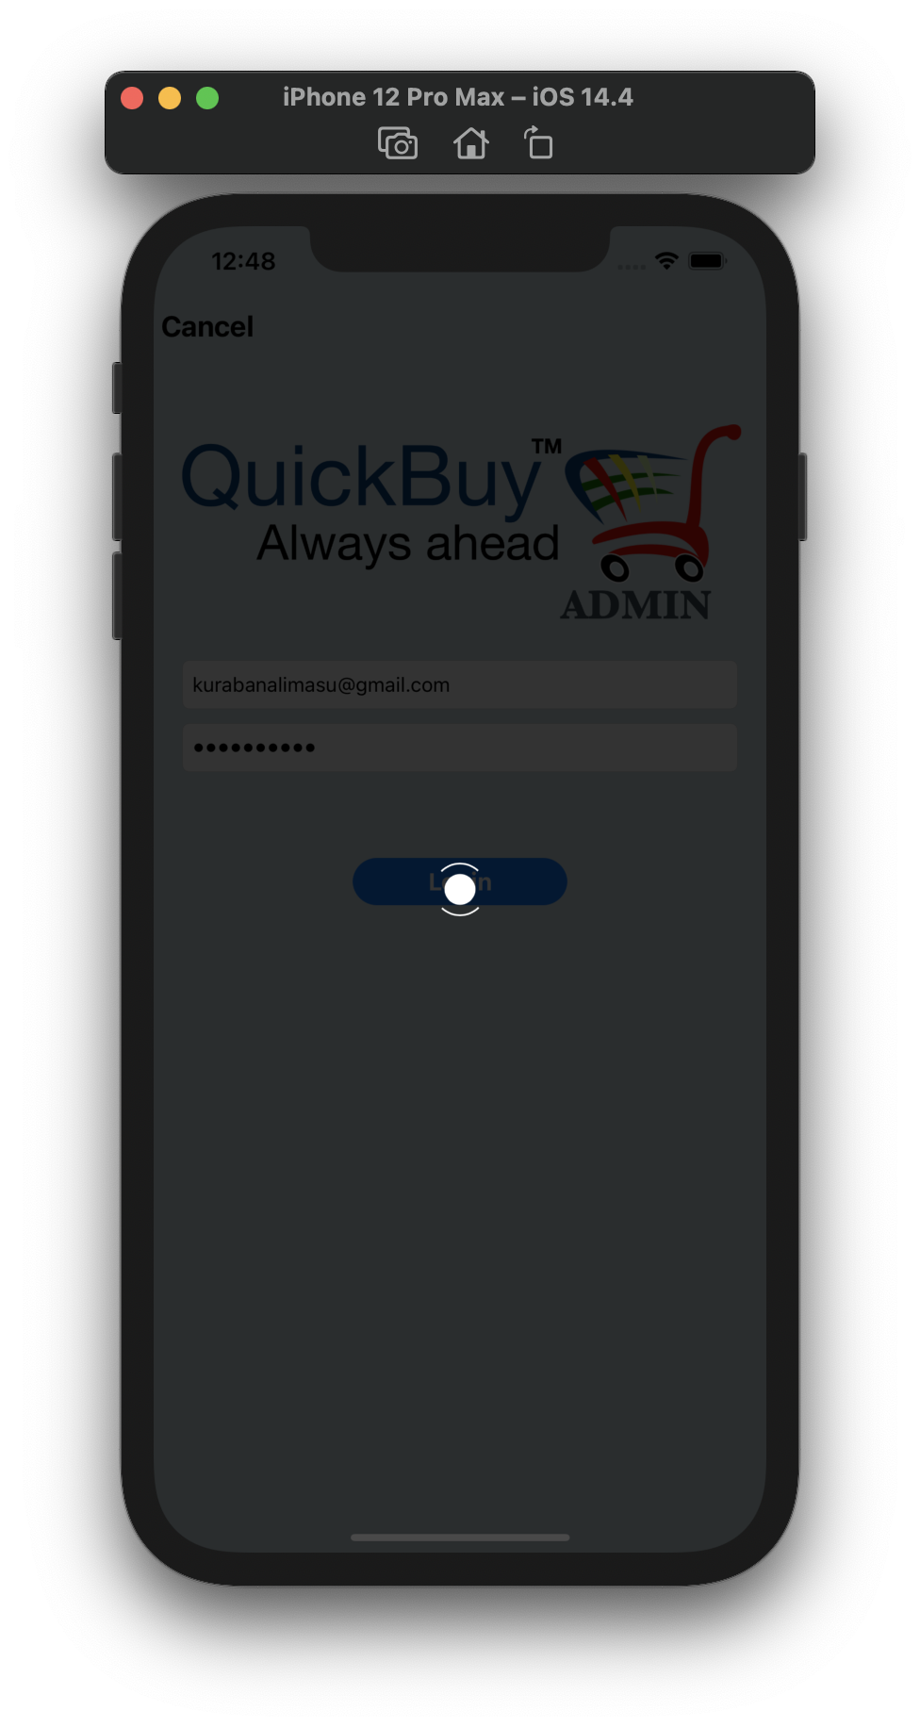
Login Screen
Login Screen
loading indicator

Slide 38
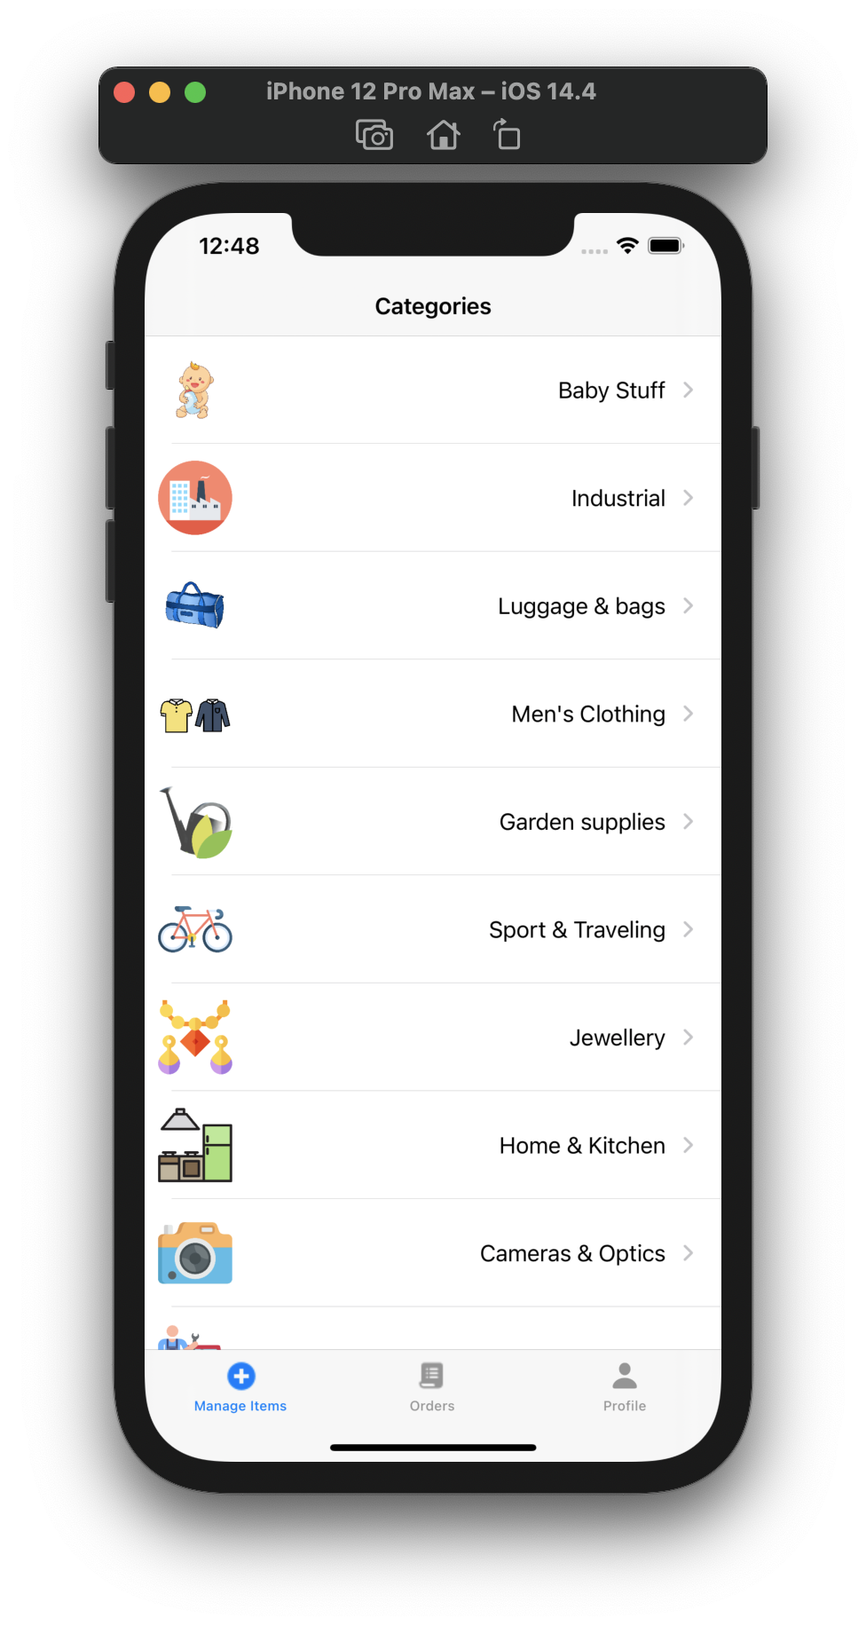
Category screen

Slide 39
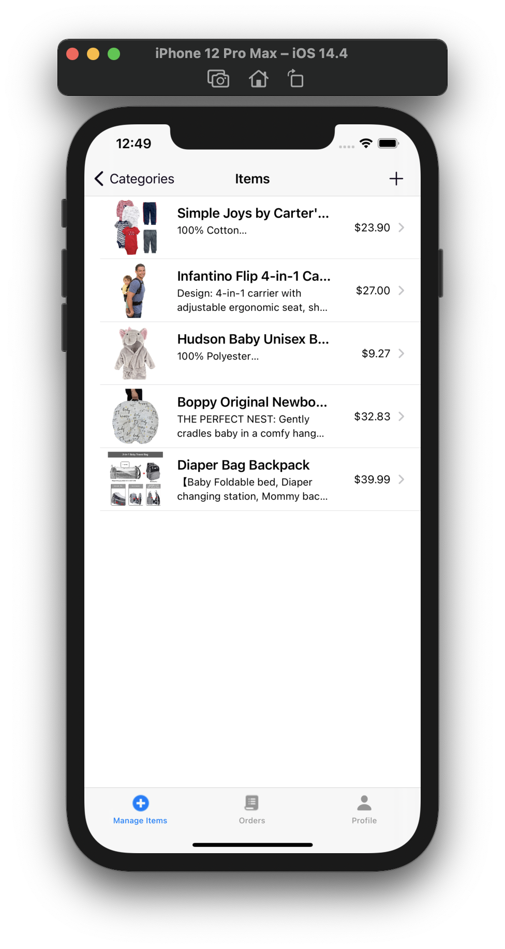
Items in Category
screen

Slide 40
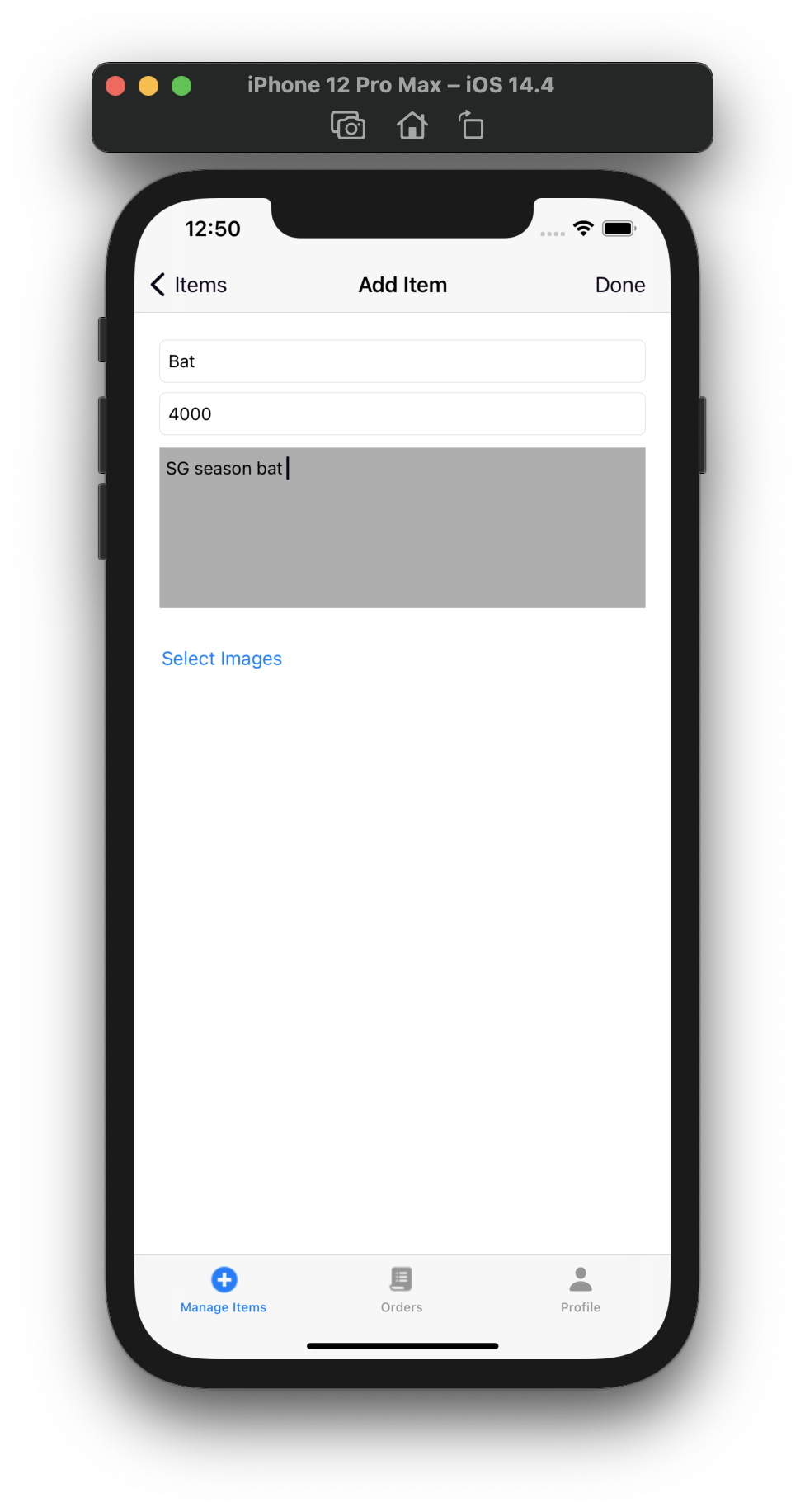
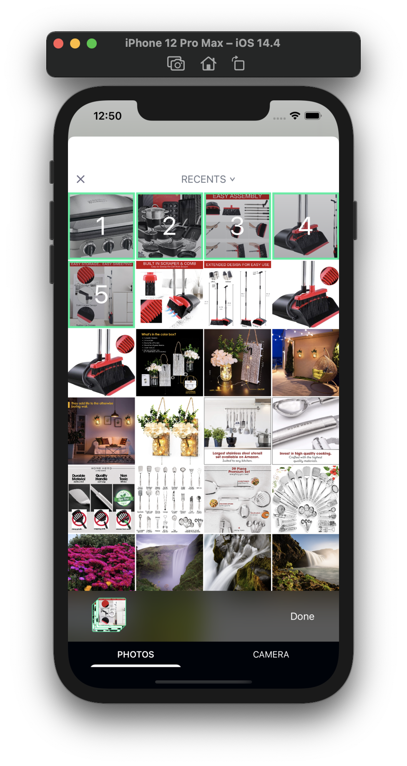
Add item screen
Image selection
in add item

Slide 41
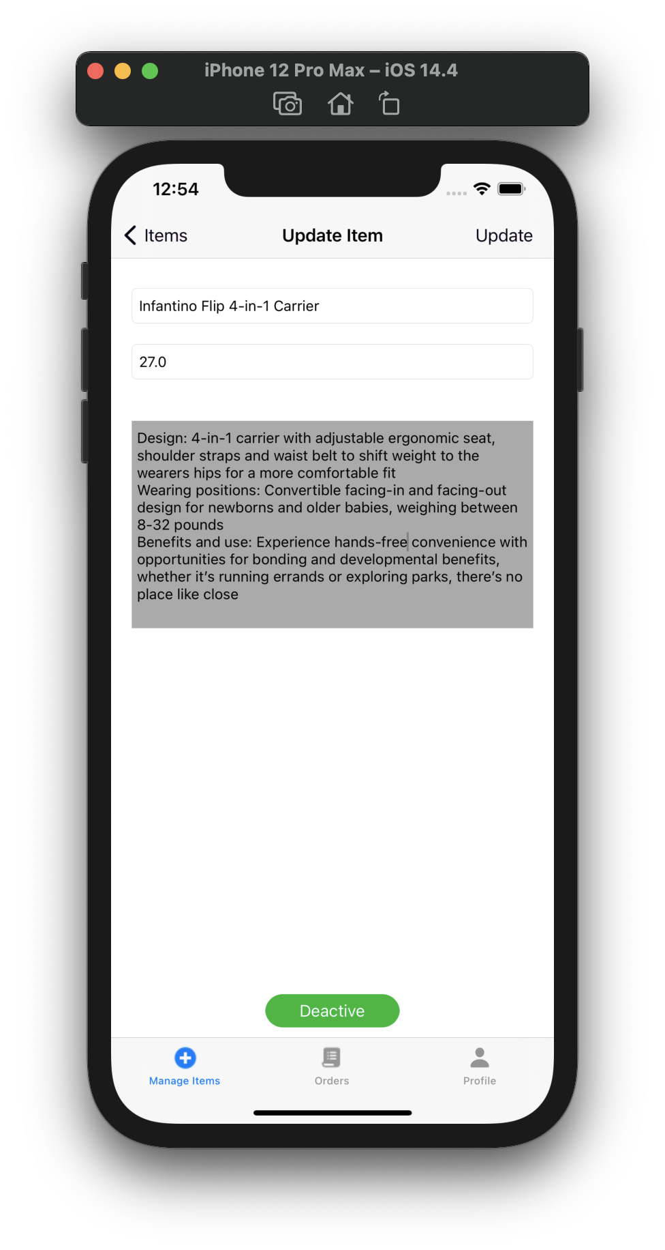
Update Item
screen

Slide 42
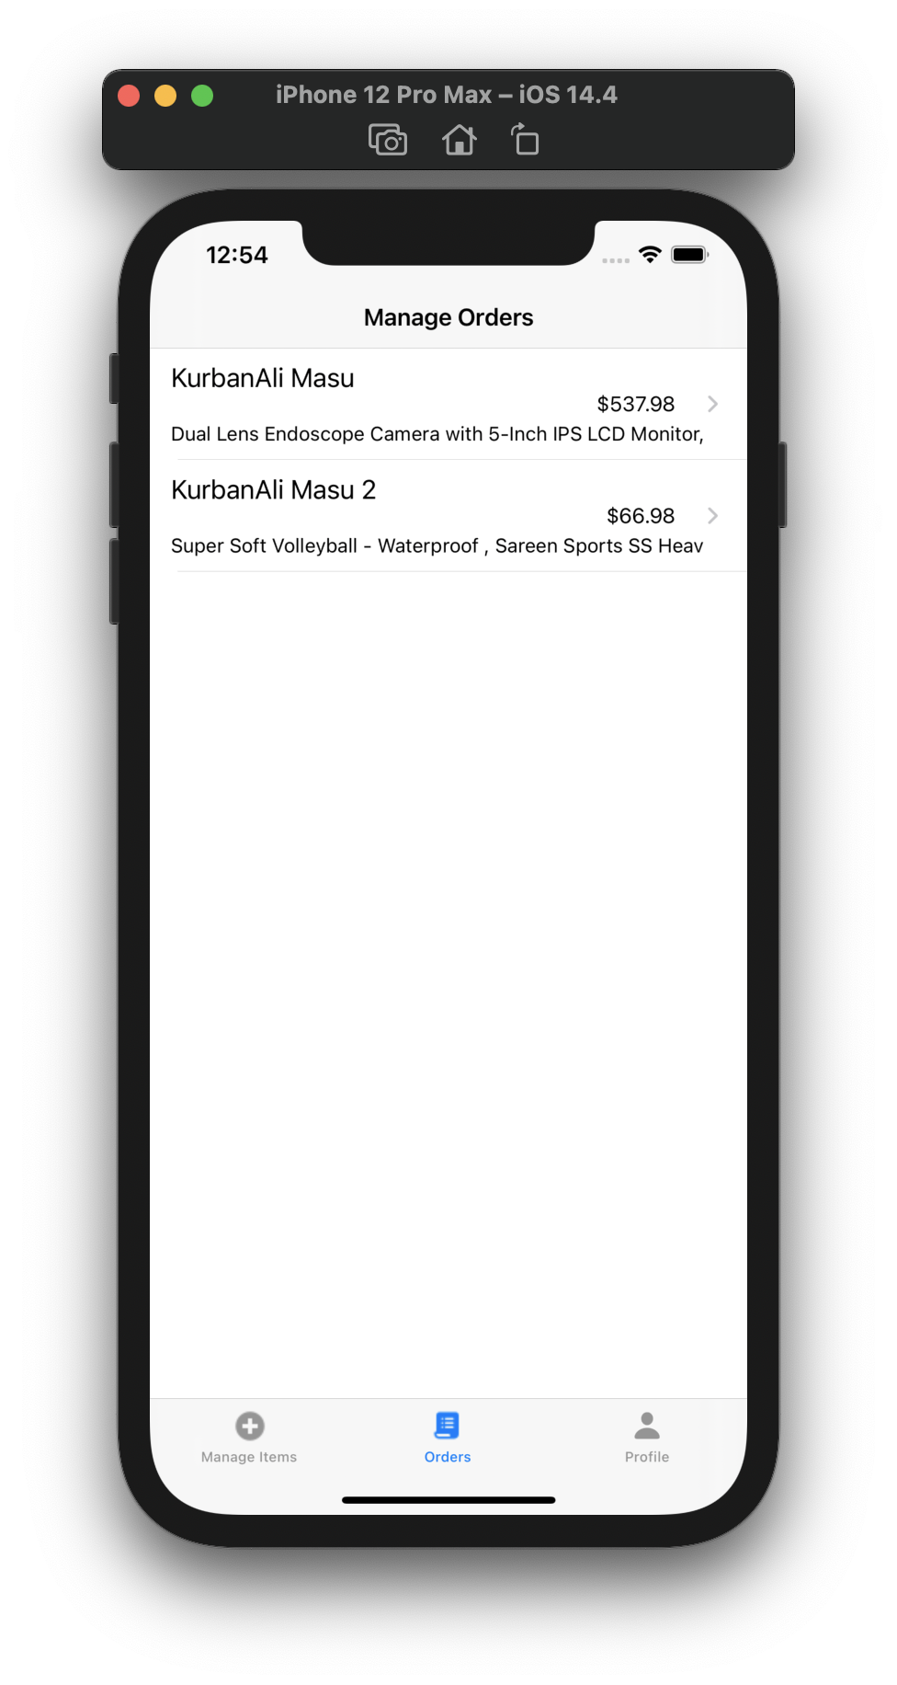
All orders view
screen

Slide 43
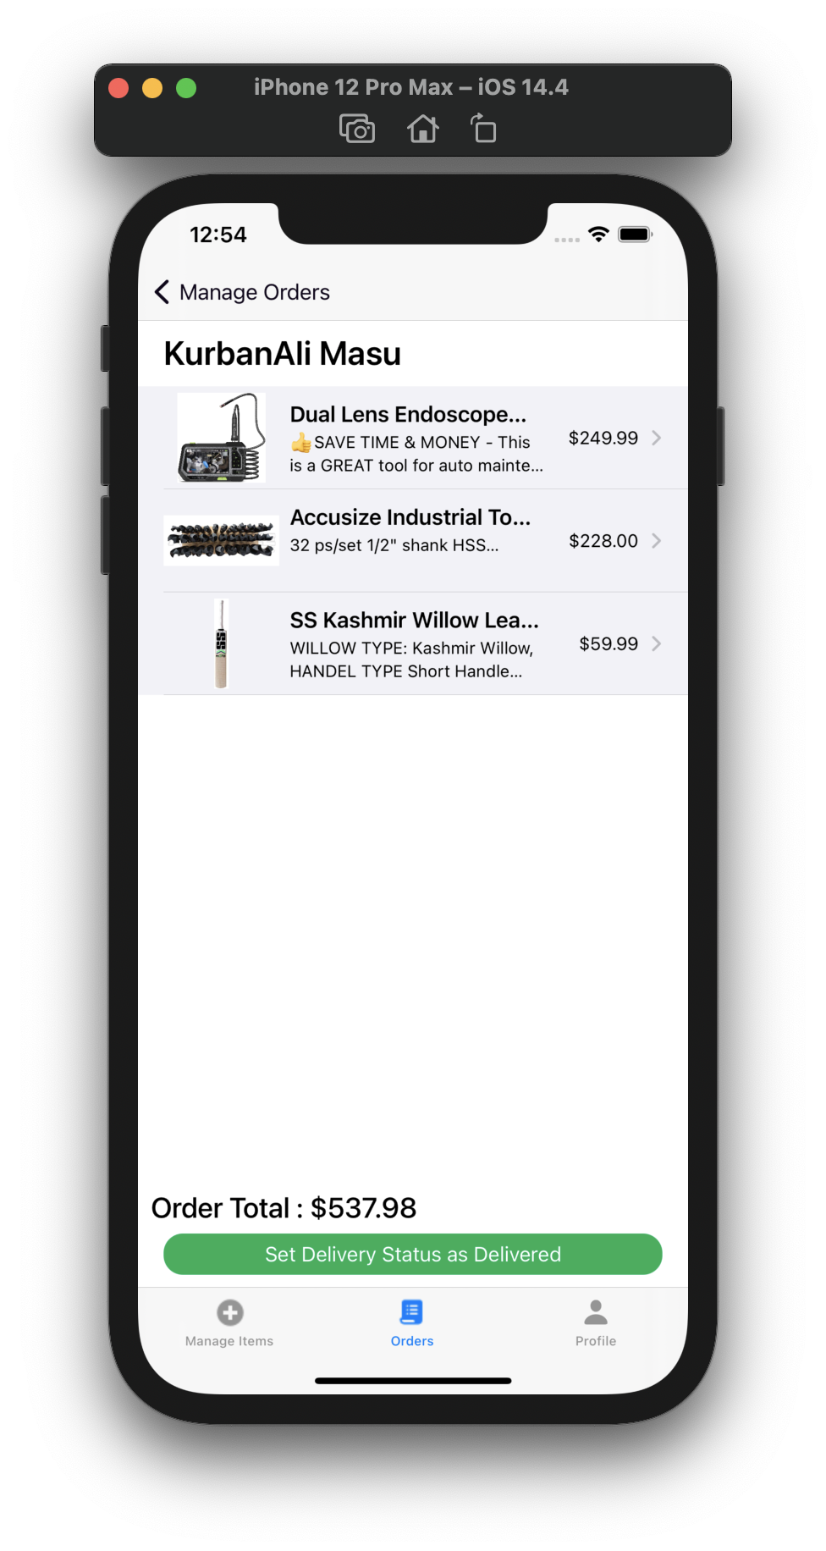
Order view
screen

Slide 44
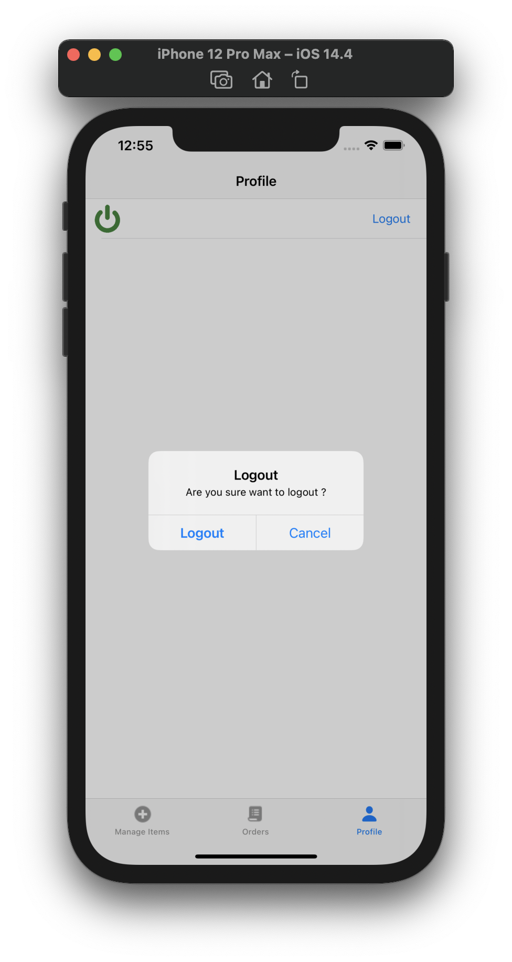
Logout Screen

Slide 45
TEST CASES

Slide 46
TEST CASES : LOGIN
NO | Test Cases | Test case id | Test Case Description | Test Data | Expected Result | Actual Result | Pass / Fail
1 | LOGIN | 1.1 | Check response when valid email and password is entered | Email: kurabanalimasu@gmail.com Password: kurban@123 | login should be successful | Login was successful | Pass
 |  | 1.2 | Check response with non-verified email and password | Email: kurbanali@gmail.com Password: kurban@123 | Show error of email not verified | Showing error email is not verified | Pass
 |  | 1.3 | Check response when invalid email and password entered | Email: kurbanali123@gmail.com Password: kurban@12345 | Show error of no user record corresponding to this identifier | Showing error no record corresponding to this identifier | Pass

Slide 47
NO | Test Cases | Test case id | Test Case Description | Test Data | Expected Result | Actual Result | Pass / Fail
1 | LOGIN | 1.4 | Try to login with empty text Field | - | Show error of all fields are required | Showing error of all fields are required | Pass

Slide 48
TEST CASES : REGISTRATION
NO | Test Cases | Test case id | Test Case Description | Test Data | Expected Result | Actual Result | Pass / Fail
2 | REGISTRATION | 2.1 | Check response when register with valid email address and password | Email: john122@gmail.com Password: john@#123 | Send verification mail to email address | Sending email to the mail address | Pass
 |  | 2.2 | Check response with invalid email and password | Email: john24553333@gmail.com Password : john@@9078567 | Show error of email address badly formatted | Showing error of email address badly formatted | Pass
 |  | 2.3 | Check response when try to register with already registered email | Email: kurabanalimasu@gmail.com Password: kurban@123 | Show error of this email is used by another user | Showing error of this email is used by another user | Pass

Slide 49
NO | Test Cases | Test case id | Test Case Description | Test Data | Expected Result | Actual Result | Pass / Fail
2 | REGISTRATION | 2.4 | Try to Register with password length less then 6 characters | Email: jack221@gmail.com Password: jack | Show error of password must have 6 or grater characters | Showing error of password must have 6 or grater characters | Pass
 |  | 2.5 | Try to register with empty fields | - | Show error of all fields are required | Showing error of all fields are required | Pass

Slide 50
TEST CASES : PURCHASE ITEM
NO | Test Cases | Test case id | Test Case Description | Test Data | Expected Result | Actual Result | Pass / Fail
3 | PURCHASE ITEM | 3.1 | Add active item to cart | - | Item will add to cart | Item added to cart | Pass
 |  | 3.2 | Add inactive item to cart | - | It will show error of item in not available currently | showing error of item in not available currently | Pass
 |  | 3.3 | Add item to cart without login | - | It will redirect on login screen | Redirecting on login screen | Pass

Slide 51
TEST CASES : SEARCH ITEM
NO | Test Cases | Test case id | Test Case Description | Test Data | Expected Result | Actual Result | Pass / Fail
4 | SEARCH ITEM | 4.1 | Search the item with valid item name | Item Name : Bag | It will show all bags | showing all bags | Pass
 |  | 4.2 | Search item with empty field | - | It will show the error of all fields are required | showing the error of all fields are required | Pass

Slide 52
TEST CASES : ORDER
NO | Test Cases | Test case id | Test Case Description | Test Data | Expected Result | Actual Result | Pass / Fail
5 | ORDER | 5.1 | Check out all the cart items and order | - | It will confirm order then place order | Confirm order then placed order | Pass
 |  | 5.2 | Cancel the order from orders | - | It will cancel the order | Cancelled order | Pass

Slide 53
LIMITATIONS OF SYSTEM
In this system we can’t manage the stock of the items.
In this system we can’t see the order delivery status.
In this system there is not online payment method.
In this system user can’t add multiple address.

Slide 54
FUTURE ENHANCEMANT
We will provide web application.
We will provide Separate app for user and admin.
We will provide order delivery status with the notification.
We will provide online payment method.
We will provide return and refund system

Slide 55
BIBLIOGRAPHY
https://swift.org
https://cocoapods.org
https://stackoverflow.com
https://firebase.google.com/docs
https://github.com
https://www.ioscreator.com

Slide 56
THANK YOU

